Slide 1
presentation begins
HERE IS WHERE YOUR
Email address and other info for ideas and suggestions

Slide 2
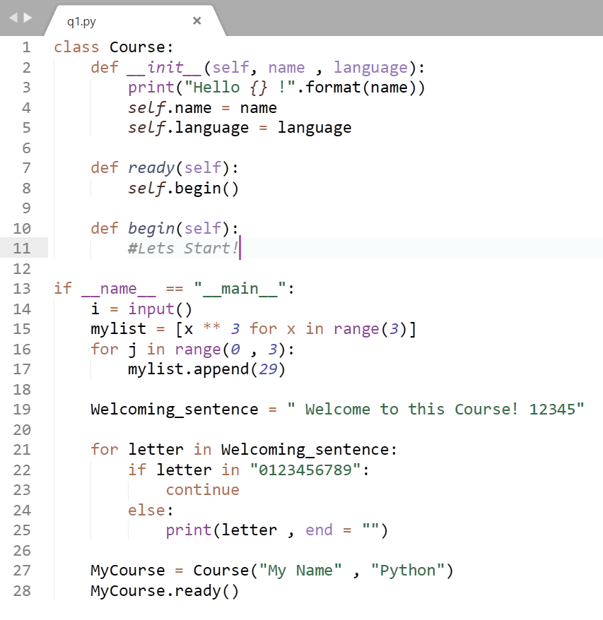
Welcome!
Introducing ….

Slide 3
Contents
Title 1
1
Title 2
2
Title 3
3
This is the subtitle that makes it comprehensible
This is the subtitle that makes it comprehensible
This is the subtitle that makes it comprehensible

Slide 4
Important information
Bluh bluh bluh bluh

Slide 5
“This Can be a quote.
—Someone famous

Slide 6
1. Title
A summary

Slide 7
Title
Main Explanation

Slide 8
Dividing to two
Pros :
1.
2.
3.
4.
Cons :
1.
2.
3.
4.

Slide 9
Dividing to two
Pros
Cons
1.
2.
3.
4.
5.
1.
2.
3.
4.
5.

Slide 10
Timeline (Other modules also available)
DAY 1
DAY 3
DAY 5
DAY 2
DAY 4

Slide 11
123
1
2
3
First one
Second
Third one

Slide 12
Infographics …
MARS
Despite being red, Mars is a cold place, not hot
JUPITER
It’s a gas giant and the biggest planet in our Solar System
VENUS
Venus has a beautiful name, but it’s terribly hot

Slide 13
… and the same goes for tables
 | MASS (earths) | DIAMETER (earths) | SURFACE GRAVITY (earths)
MERCURY | 0,06 | 0,38 | 0,38
MARS | 0,11 | 0,53 | 0,38
SATURN | 95,2 | 9,4 | 1,16

Slide 14
Thanks!
Questions?
Here’s other contact info:

